Slide 1
Python Course Introduction
Ronan Paugam

Slide 2
CONTENT
Quick introduction
Practical with Jupyter Notebook

Slide 3

Introduction
Invented in the Netherlands, early 90s by Guido van Rossum
Named after the Monty Python
Open sourced from the beginning
Considered a scripting language, but is much more
The python script (.py extension) is a file containing the commands that are structured to be executed.
But how do you run it?
What do we exactly mean by running a Python Script

Slide 4
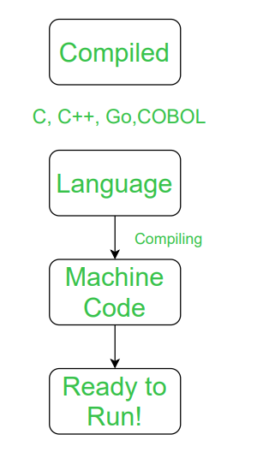
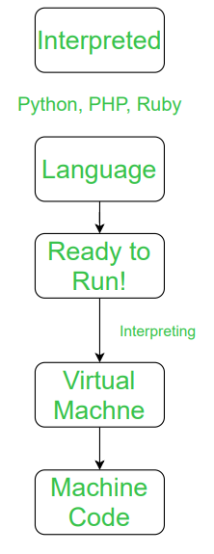
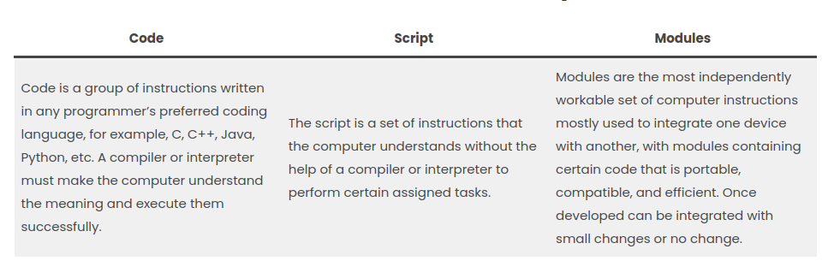
Scripting Language: interpreted vs compiled language
A scripting language is a programming language that is used to manipulate, customize, and automate the facilities of an existing system. Scripting languages are usually interpreted at runtime rather than compiled.
(Wikipedia)
an interpreter is a computer program that directly executes instructions written in scripting language, without requiring them previously to have been compiled into a machine language program.
vs

Slide 5
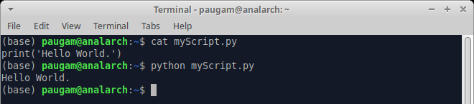
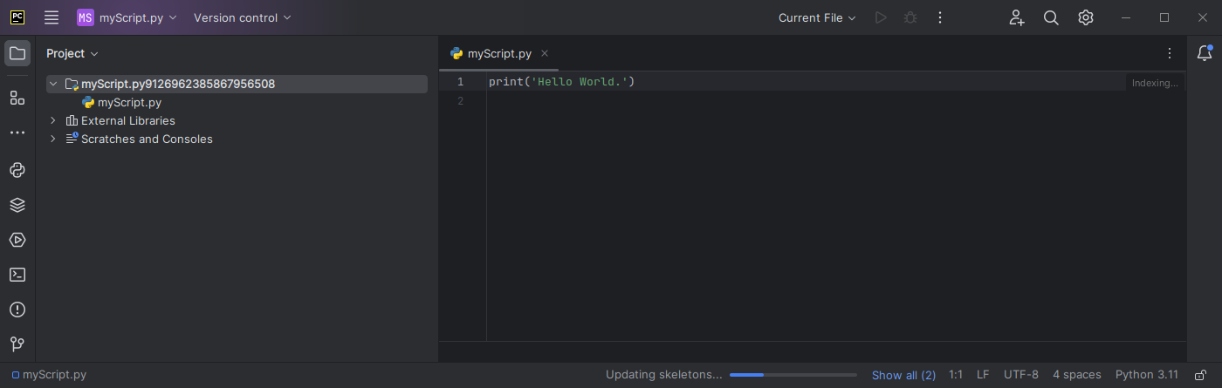
How To run python script
from terminal:
Python is available in all os.
Scripts can be edited with many text editor: e.g. sublime.
from IDE (Integrated development environment Software): example PyCharm
Python interpreter comes with the IDE

Slide 6
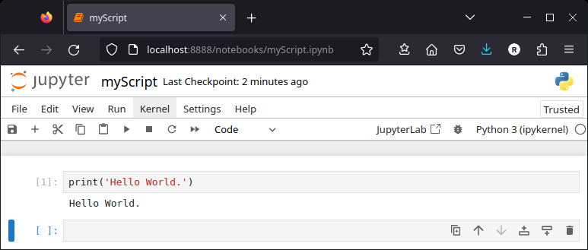
How To run python script
From Jupyter notebook:
Its name and logo are an homage to Galileo's discovery of the moons of Jupiter
A Jupyter Notebook is a browser-based application containing an ordered list of input/output cells which can contain code, text (Markdown syntax), graphics.
Its File extension is .ipynb

Slide 7
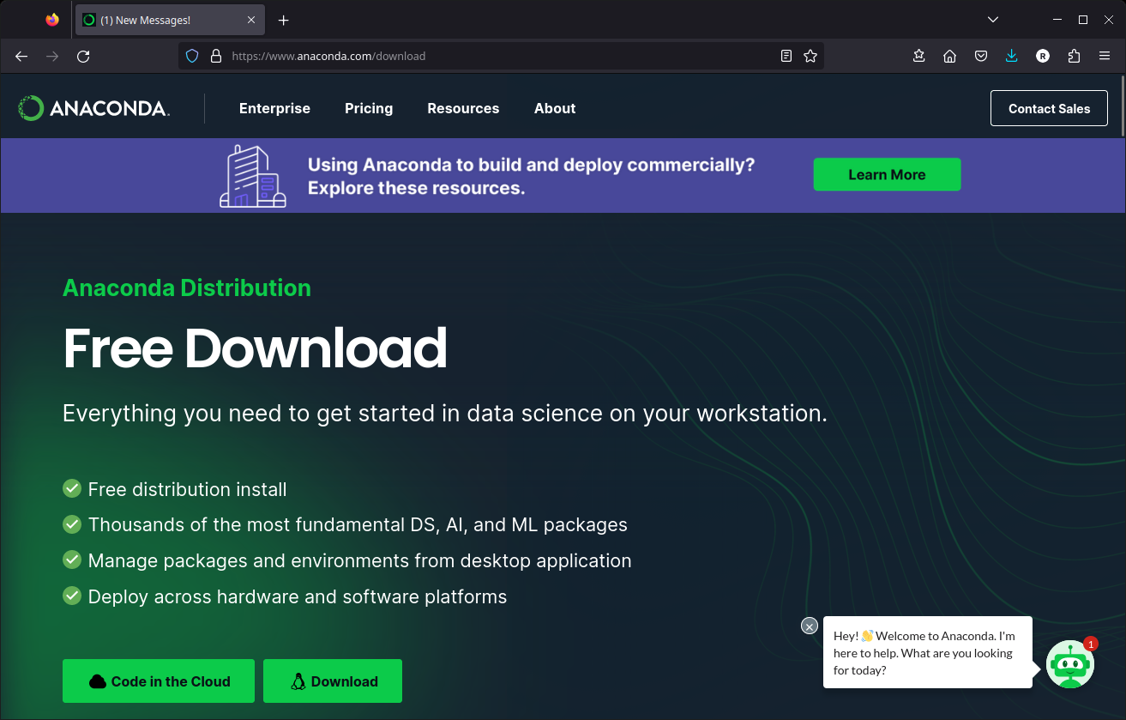
How to install python interpreter:
To install simple python interpreter or jupyter notebook, the easiest way is to install a python environment such as Anaconda.
Anaconda allows to install several side by side environments with selected modules (i.e. librairies). It ensures version compatibilities between modules.
By defaults, anaconda contains a jupyter server.

Slide 8
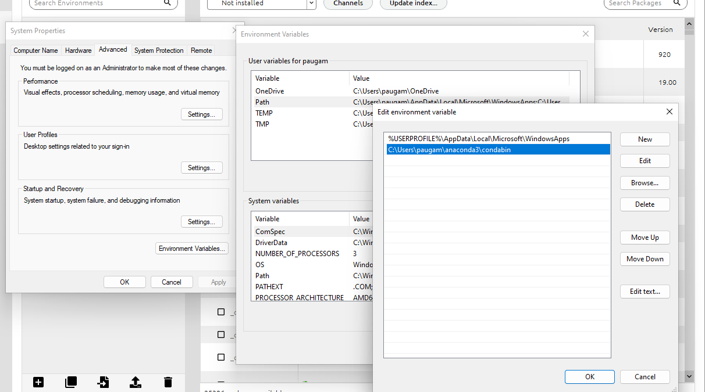
How to install python interpreter:
For the practical you need to install a new environment with dedicated package:
Add new channel: conda-forge
Create new environement
Add packages:
Numpy
Scipy
Geopandas
Matplotlib
Rasterio
opencv
Install by clicking on Apply
Once again add package
Jupyter
Install by cliking on Apply
Add condabin to your os path
From windows menu enter “environement variable”
then add C:\Users\yourUserName\anaconda3\condabin

Slide 9
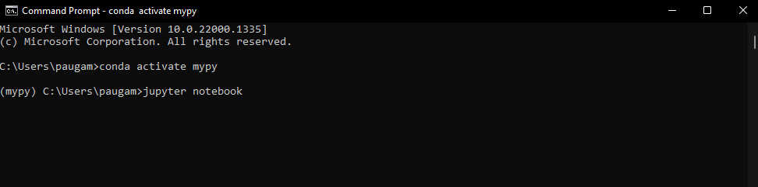
How to start jupyter notebook:
For an anaconda environment named mypy, in a prompt run:
A browser should automatically open.
Then navigate to your notebook (.ipynb) file.

Slide 10
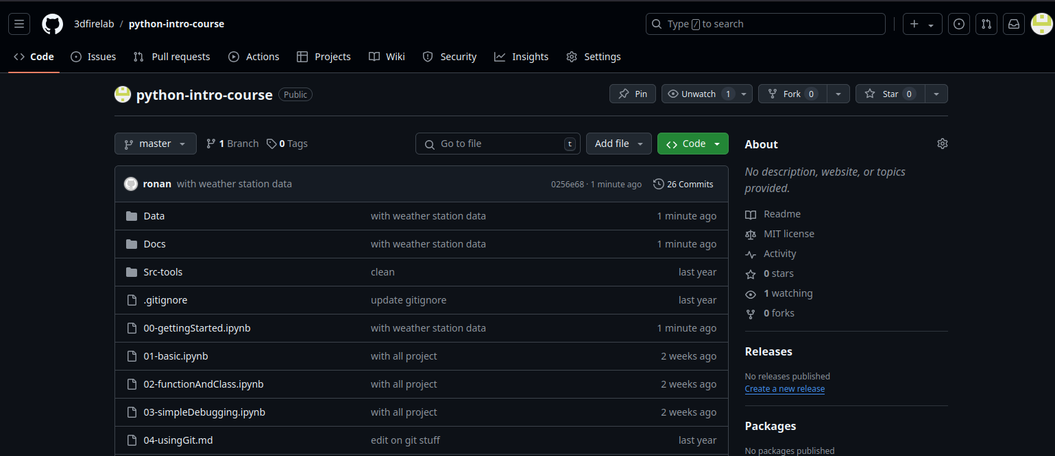
Download Material from github
In your browser go to https://github.com/3dfirelab/python-intro-course/blob/master/00-gettingStarted.ipynb
to get starting instruction

